Slide 1
The L-CAM Project
A lunar-based telescope for astronomical observations
Notes:
L-CAM stands for Lunar camera

Slide 2
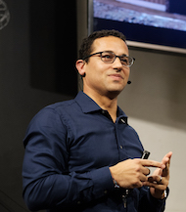
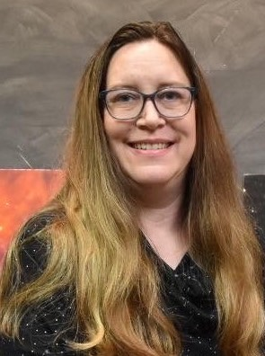
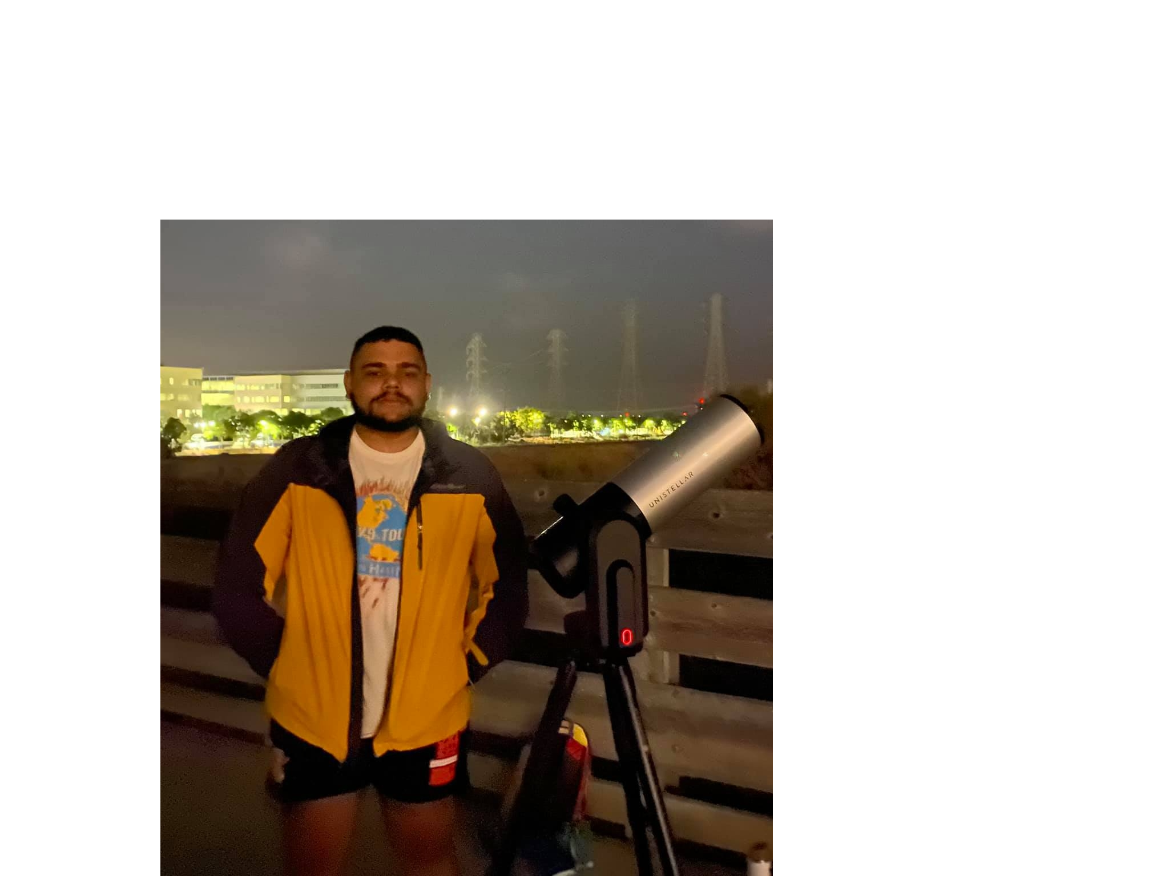
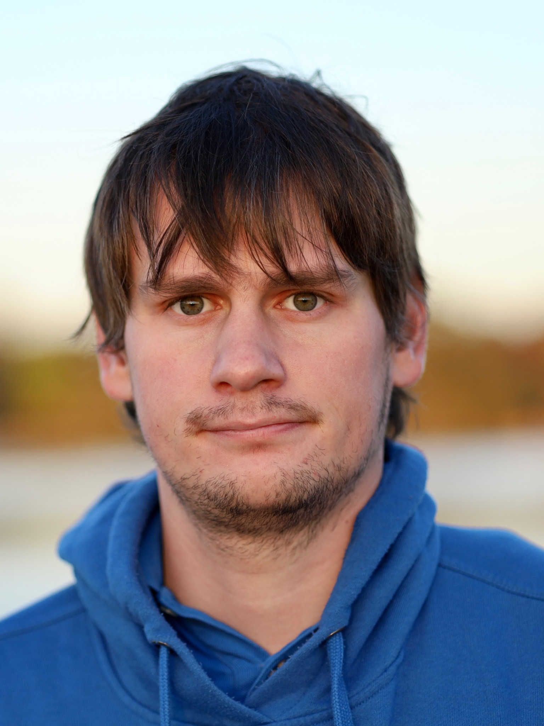
The Team
Tabetha Boyajian, LSU
Jessie Christiansen, Caltech/IPAC
Franck Marchis, SETI Institute & Unistellar
Angelle Tanner,
MSU
Matthew Penny,
LSU
Farzaneh Zohrabi,
LSU
Connor Langevin, LSU
Jonas Klüter, LSU
Carol Miu,
LSU, UW Bothell, Collin College
Peter Santana, UPRM, SETI Institute & Unistellar
Acknowledgement: This project is funded in part by the Gordon and Betty Moore Foundation through Grant GBMF10467 to AstronetX PBC. Participation of CM made possible by the LSU REU program (NSF award PHY-1852356). Participation of PS-R made possible by the SETI Institute REU program (NSF award 2051007).
Notes:
Bottom row: Early career members of the team

Slide 3
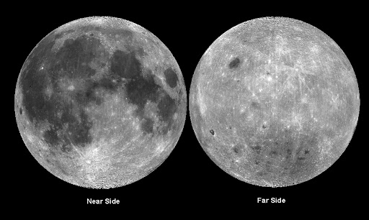
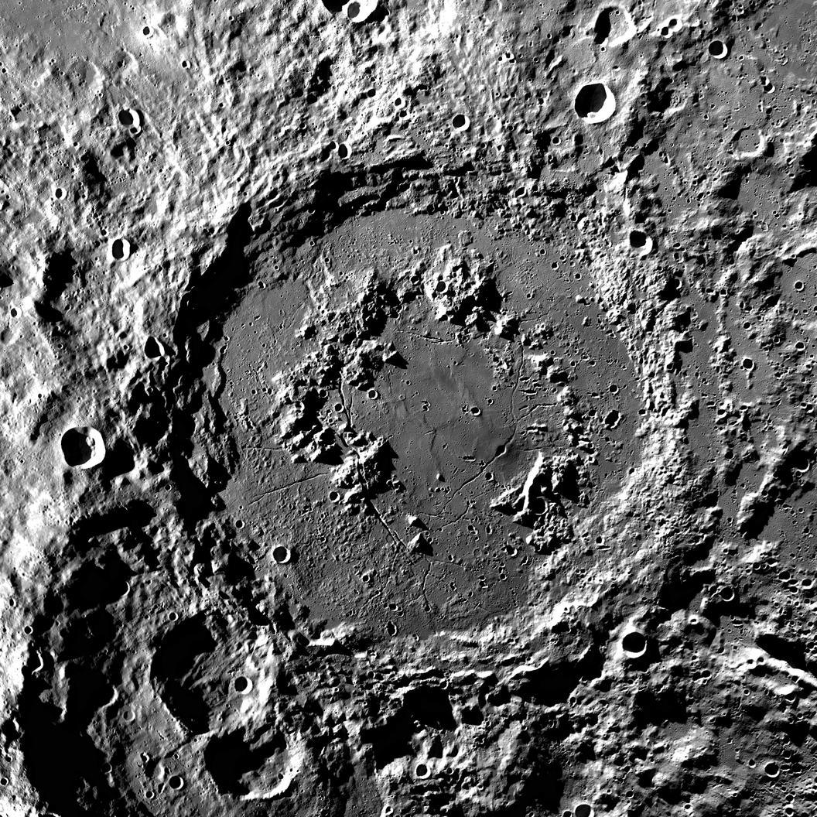
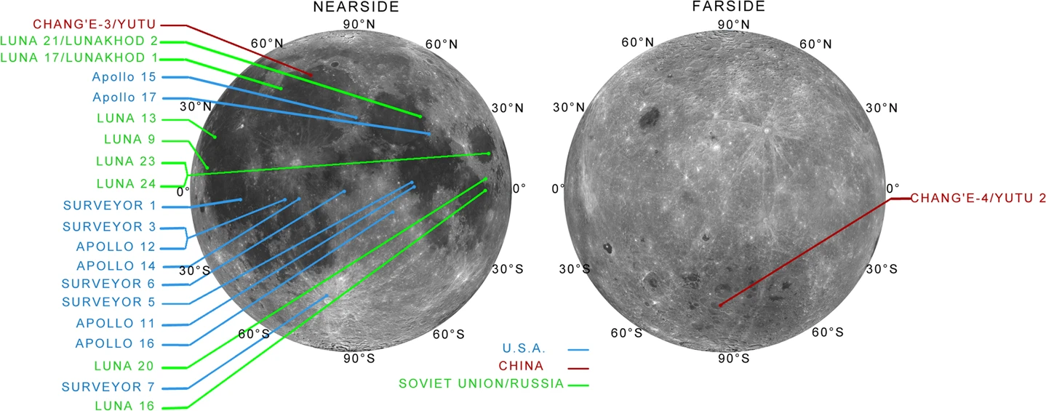
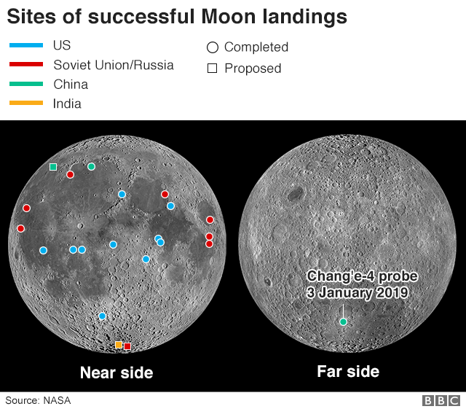
The Moon
Why put a telescope
on the Moon?
Only one side of the Moon is visible from Earth
Schrodinger Basin: 75°S, 135°E
Stable environment/no atmosphere
Continuous monitoring of the sky for two weeks at a time
Can observe objects in Earth’s daytime sky
Schrodinger Basin
Notes:
Only one side of the moon is visible from Earth. → near side and far side.
Schrodinger Basin is on the far side near the south pole.
In total, there have been 22 successful moon landings (19 of them taking place from 1966 and 1976, from US and Russia).China has had 3 successful landings (2013, 2019, 2020)
The US hasn’t landed on the moon since apollo 17 (1972) - 50 years! All 6 Apollo landings on near side.
China’s Chang-e 4 lander is the only lander on the Moon’s farside.
There is also a lot of interest in putting radio telescopes on the farside since the moon with block terrestrial transmissions to help observe astronomical signal with less interference.

Slide 4
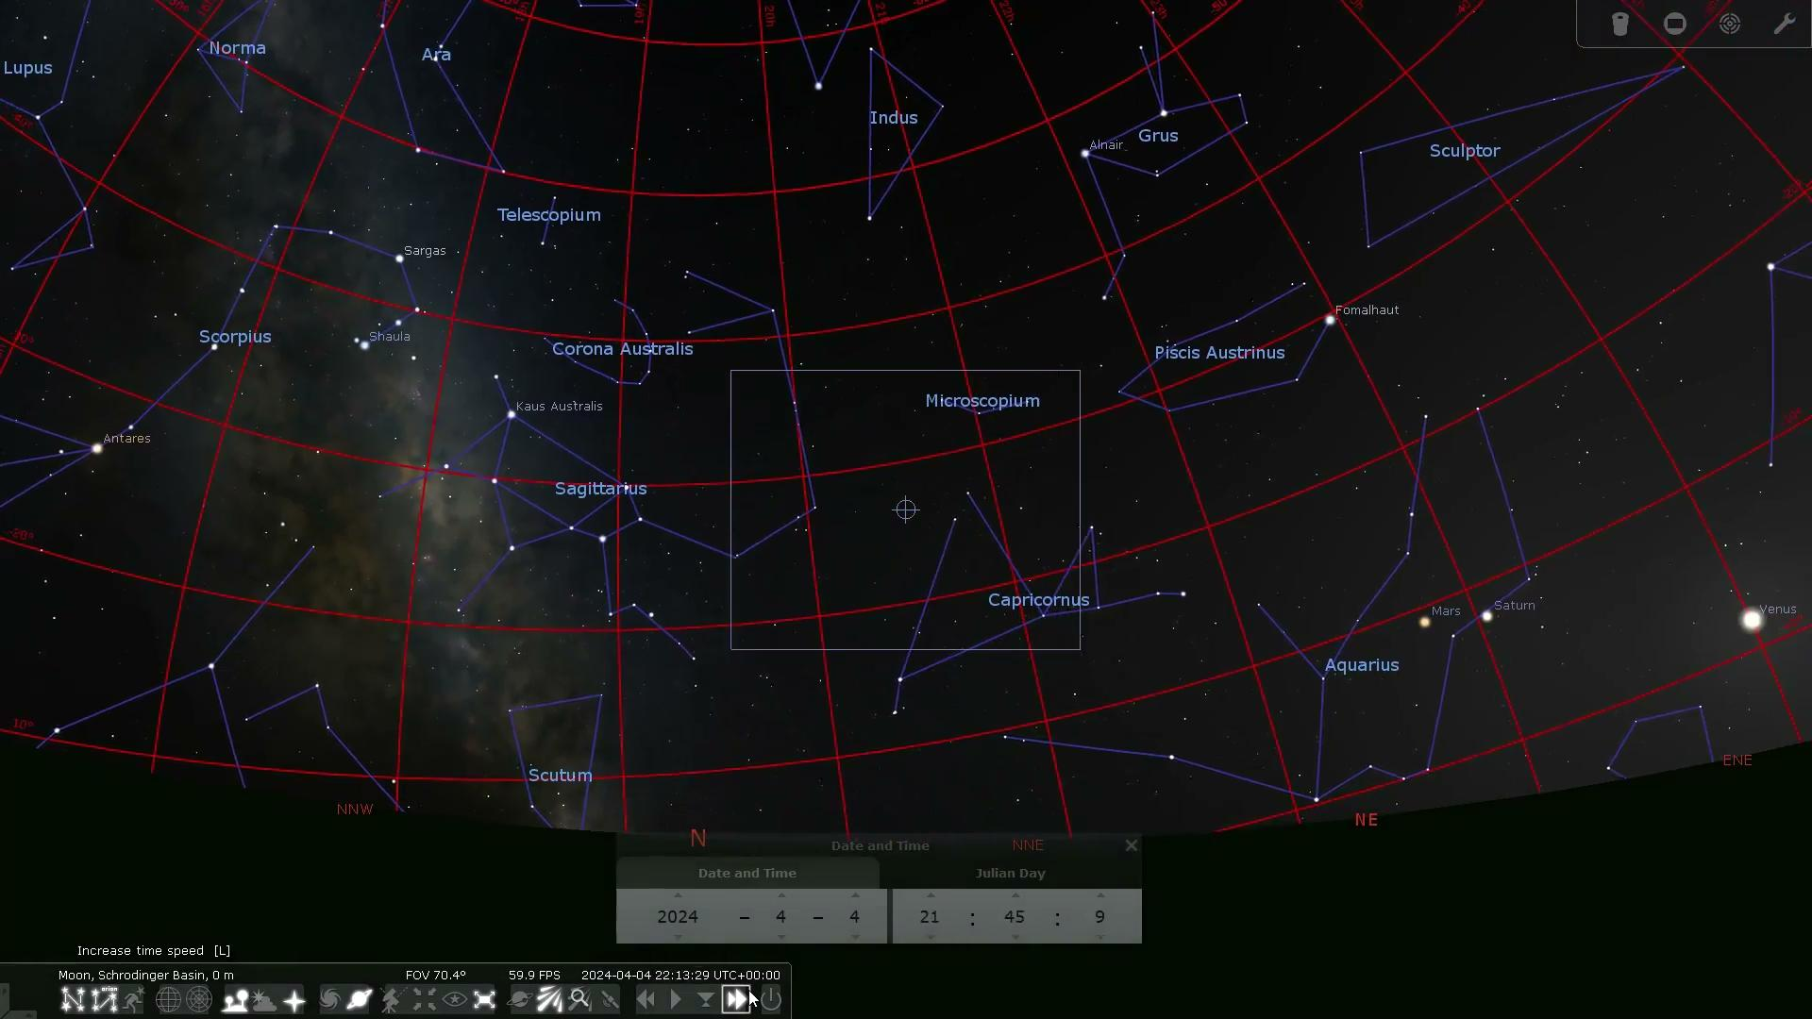
What does the sky look like from the Moon?
L-CAM full-field image (from Earth) showing the Orion constellation
Notes:
One second = 1 day
Our study based on static camera pointing. A future version of Lcam will follow the stars as they move across the sky.
This is analogous to Arecibo Observatory or Sloan Digital Sky Survey where the telescope points in a single direction and lets the stars move across the Field of View

Slide 5
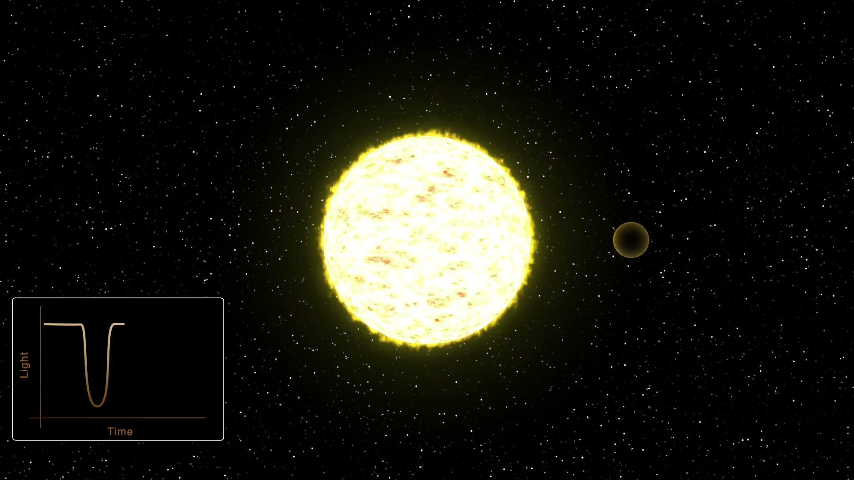
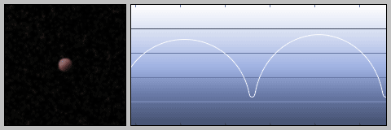
Science Motivation: Exoplanet transits
Anticipated results:
Detecting new transiting exoplanets
Refine orbits
Characterize properties
Video credit: NASA
Notes:
L-CAM will collect “light curves”, a measure of the brightness of a star over time, continuously throughout the Lunar day. If a planet is orbiting the star in our line of sight, the star’s brightness will temporarily decrease as the planet crosses between us, an event known as a transit. Continuous, precise observations reveal properties important for characterizing and understanding the system.
Most of the exoplanets to date have been found via transits either with Kepler or TESS. The transit method has the advantage of allowing for the planet’s radius and (with radial velocity) mass to be measured. L-CAM will allow us to collect additional transits of the systems which may lead to what is stated above.

Slide 6
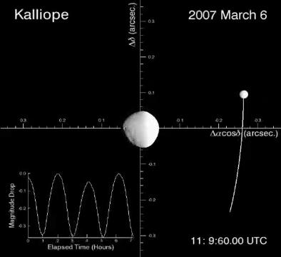
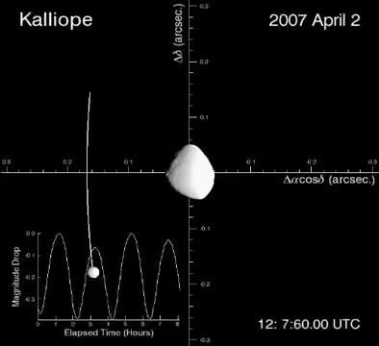
Science Motivation:
Asteroids
Anticipated results:
Rotation, shape and multiplicity of 100s asteroids, mostly in the main-belt
Mutual events in multiple asteroid systems
Video credit: Descamps et al. 2008
Notes:
100s asteroids can be studied using LCAM (spin period, shape, and multiplicity) Recording light curves of asteroids over long time periods and with great photometric precision is essential to detecting mutual events.

Slide 7
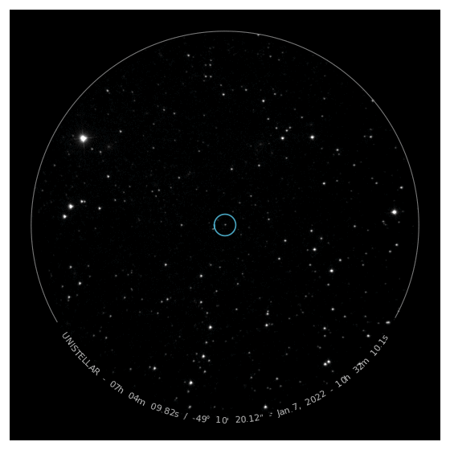
First Planetary Defense Facility on the Moon
A Planetary Defense telescope on the moon to complement Earth-based ones
At least one Near-Earth Asteroid observable with L-CAM every month
Science goals: orbit, shape, moon around known potentially hazardous asteroids
Potentially Hazardous Asteroid 1km 1994PC1 observed on January 7 2022 from NZ (individual 4-s frames combined together). Credit: Unistellar/SETI Institute
Notes:
1994PC1 is a 1km PHA; scheduled to flyby Earth Jan 18 at 5 times Earth-moon distance

Slide 8
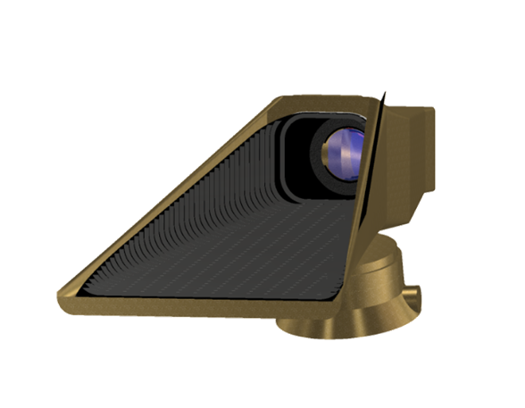
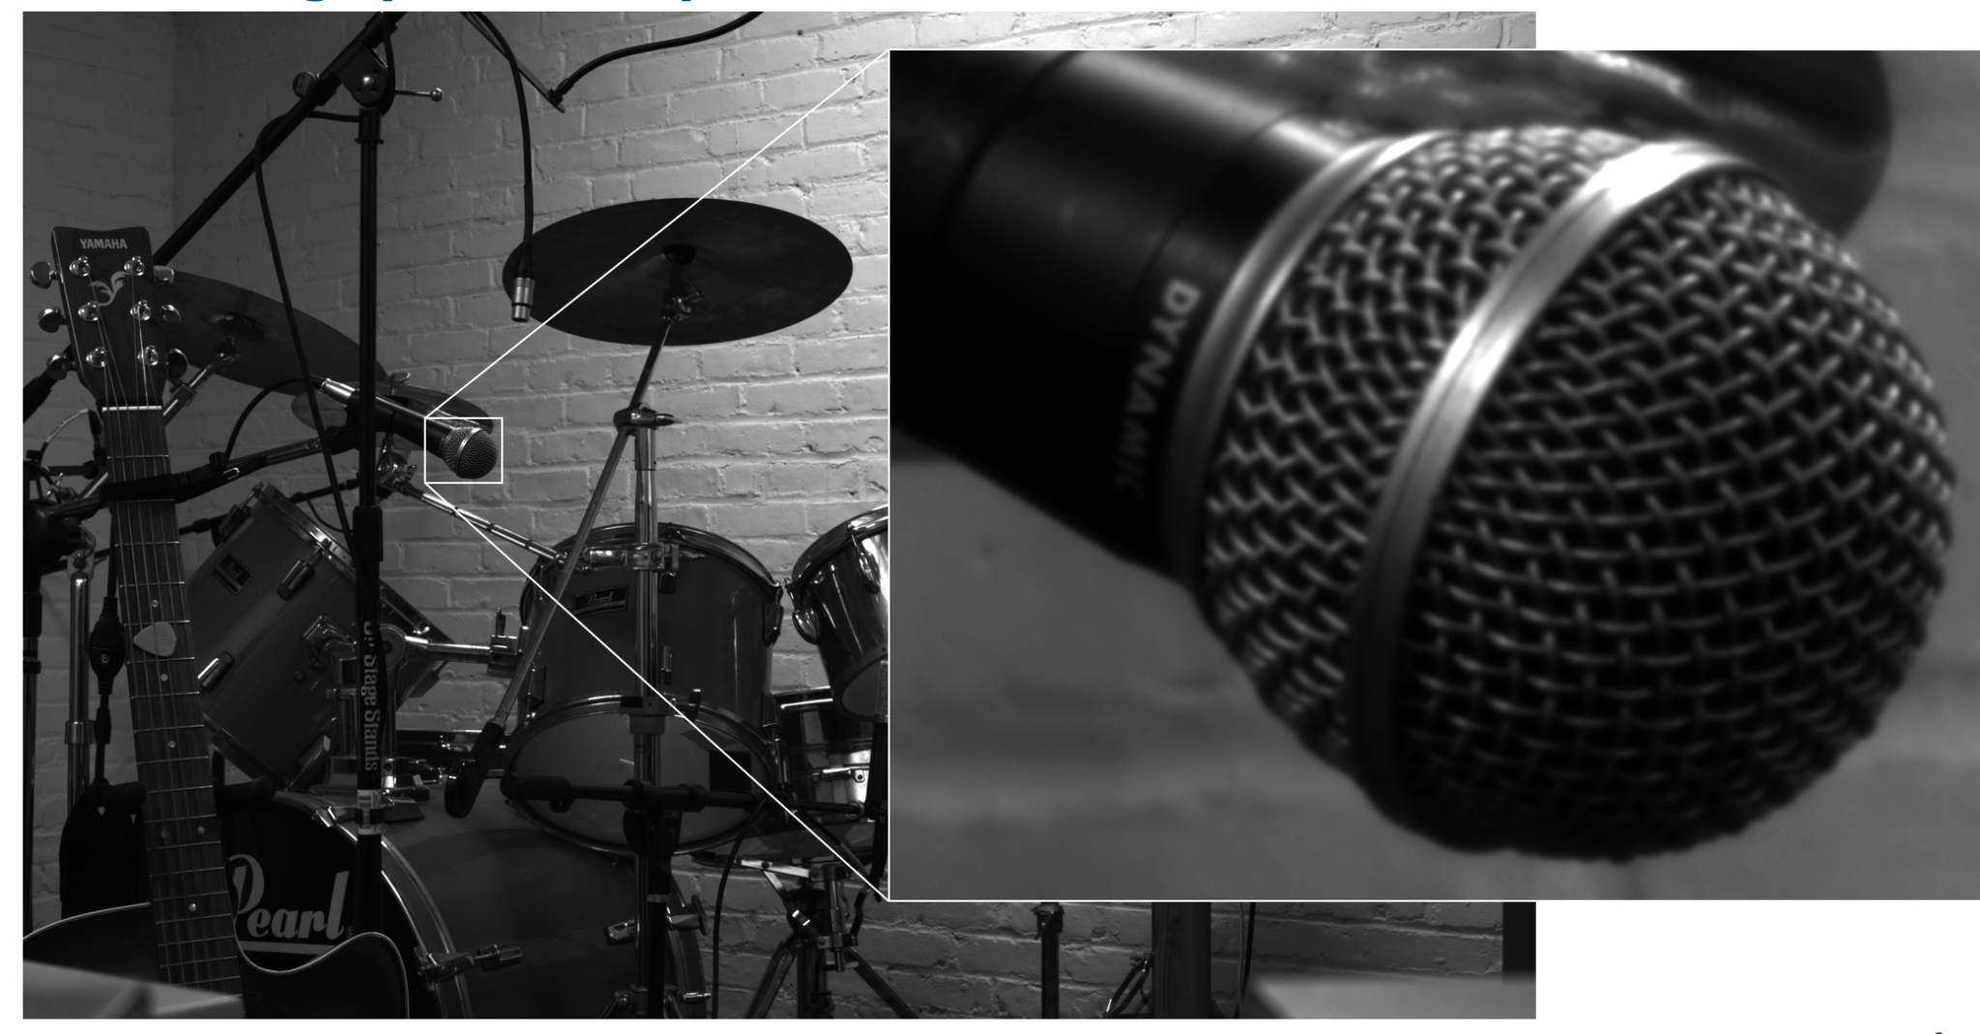
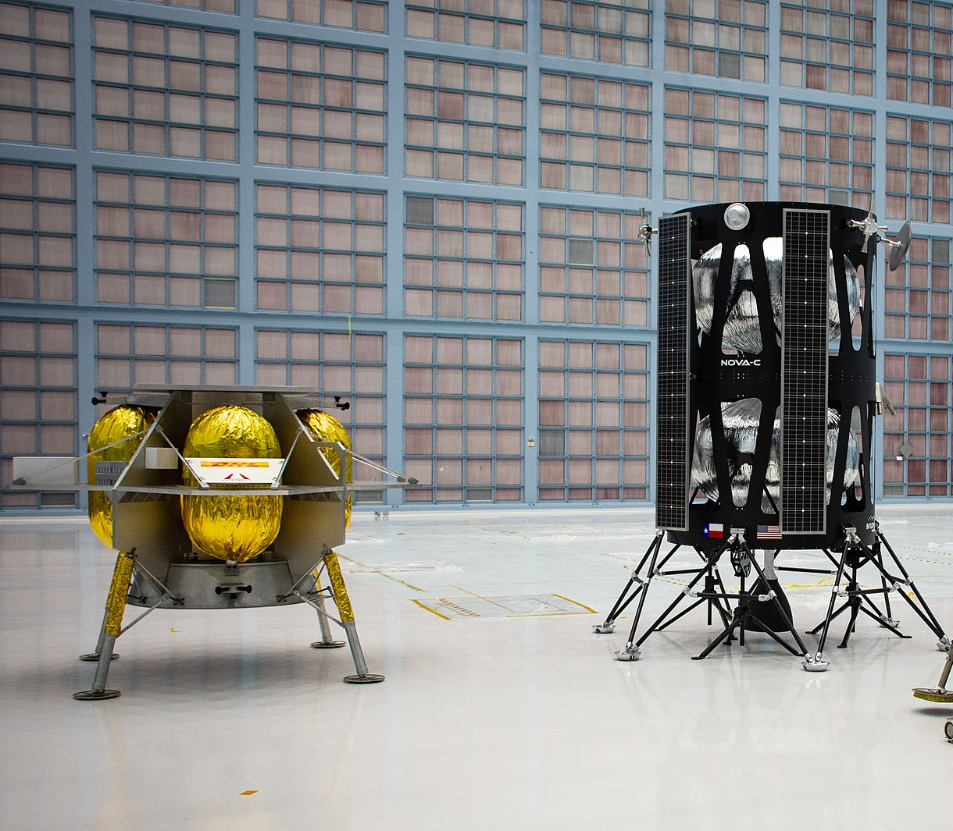
Scope of work I
L-CAM design
Characterize the instrument
Configure instrument for optimal data quality and science productivity
Models of the first two NASA commercial landers
L-CAM example reference image
Notes:
Drum set: Reference image showing field of view and the resolution of the camera.
What will L-CAM images look like? What kind of settings are needed for the best quality data?
Bottom right: First landers launching in the next few months (2022).
L-CAM: a small (5cm) telescope. The “duck-bill” shields the instrument from reflected sunlight off the Lunar surface.

Slide 9
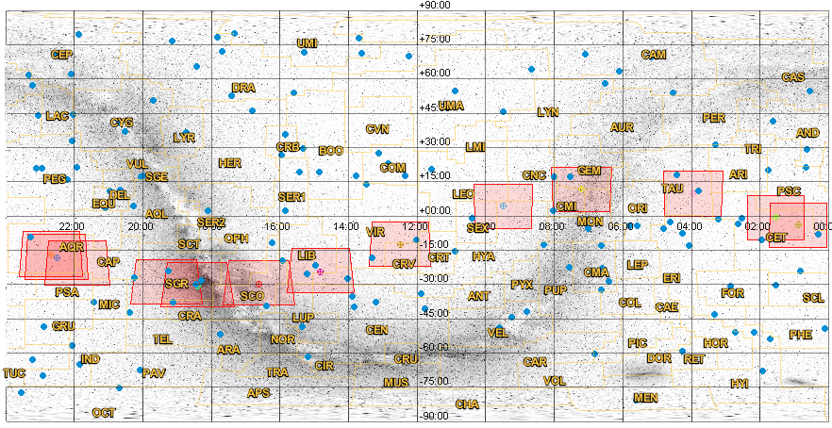
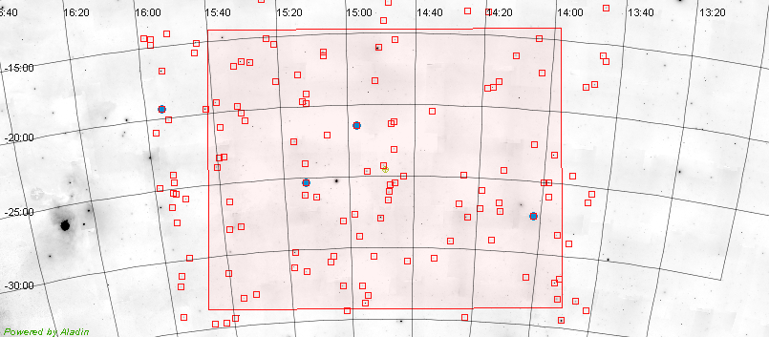
Scope of work II
Science program
Create lists of science targets to observe for a 12 month period.
Establish observing plan
Develop data calibration and analysis plans
Evaluate different strategies to accommodate daily download rates/limits
All sky map showing L-Cam footprint at the first of each month in 2024. Constellations are traced and labeled in orange. Naked-eye exoplanet host stars are marked in blue.

Slide 10
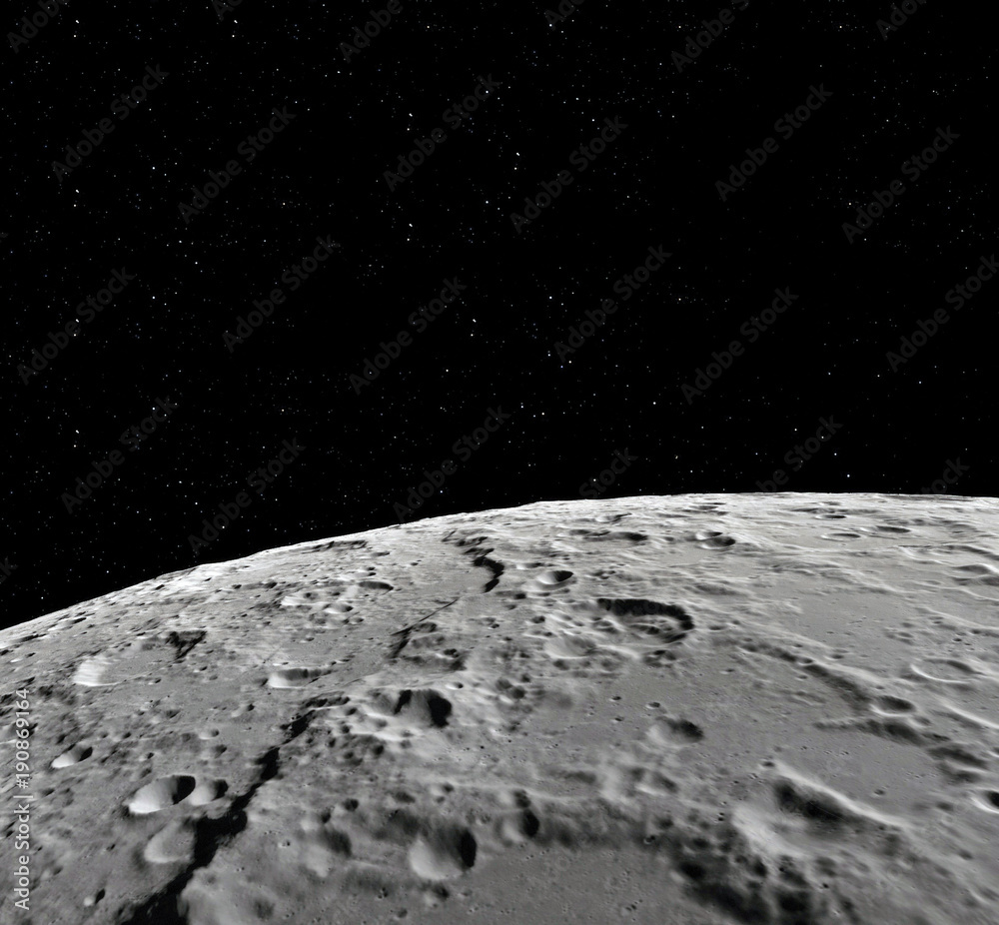
Summary: The Dawn of
Astronomy on the Moon
Targeted launch in 2024, operating for 1 year
Light curves of ~4 dozen planet hosting bright stars and 100s of main-belt asteroids
Detection and characterisation of dozen near-Earth asteroids
Notes:
https://svs.gsfc.nasa.gov/4944
Lander?

