Slide 1
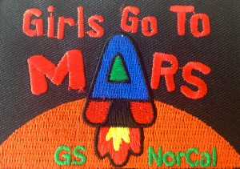
Girls Go to Mars: Activity Tips for Adult Leaders
Photo Credit: NASA – Orange Planet Mars
©SETI Institute 2015

Slide 2
Table of Contents
“Click” on the desired link below: Activity 1: The Goldilocks Question: Just Right, Too Cold, or Too Hot - A Scale Model of the Inner Solar System
Activity 2: It’s All About the Atmosphere
Activity 3: How Do Atmospheres Change Over Time? - The Role of the Magnetosphere & Solar Wind
Activity 4: Evidence for an Atmosphere on Mars Over Time: - Water Surface Features
Activity 5: How Do Atmospheres Change Over Time? - The Greenhouse Effect
Activity 6: Steps Along the Journey: - Global Warming
- Terms
©SETI Institute 2015 Girls Go to Mars Tips for Adult Leaders

Slide 3
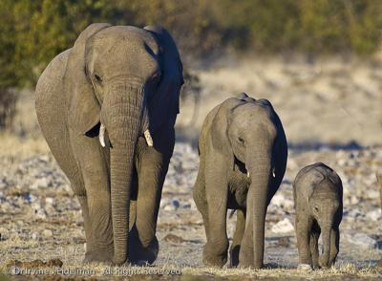
Activity 1: A Scale Model of the Inner Solar System
Materials-in-Brief: Consult Activity for complete list
2 - dolls or action figures
10 - scaled objects representing inner and outer planets
2- labeled balls: Earth; Mars – ½ diameter of Earth’s ball
Big Picture Ideas: Activity 1 introduces concepts of scale and scale models to help girls better grasp the vast size of our Solar System. Scale can simply be defined as the size of an object in relation to another object. For example, look at any photograph of the three elephants. Decide how many baby elephants will stack, one on top of the other, next to big mama? (Answer: about 2 ½.) Would your answer be 2 ½ for the other photographs? YES! You can build many 3-D scale models from the information in one elephant photograph as long as you use the relative size relationship between the three elephants for your model.
Credit: NASA APOD 3/12/2012
©SETI Institute 2015 Activity 1: Scale Model of Solar System [Adult]

Slide 4
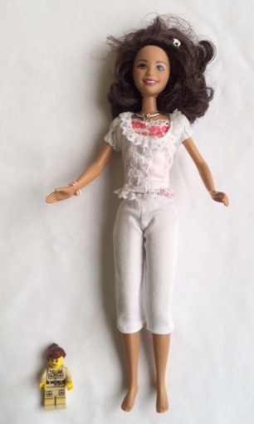
Activity 1: A Scale Model of the Inner Solar System
Materials-in-Brief:
2 - dolls or action figures
10 - scaled objects representing inner and outer planets
2- labeled balls: Earth; Mars – ½ diameter of Earth’s ball
Activity 1 begins when leaders show two dolls to the girls. As with the elephant images, the dolls are helpful in communicating the idea of “scale”. (Note: Scale Is defined as the size of an object in relation to another object.) Note the dolls have several shared features – hair, legs, arms and also height. In this example, the large doll is about five times taller than the small doll and clothing items reflect this relative size difference. For instance, shoes on the small doll won’t fit the feet of the large doll. Clothing is scaled to fit the size of each doll.
©SETI Institute 2015 Activity 1: Scale Model of Solar System [Adult]

Slide 5
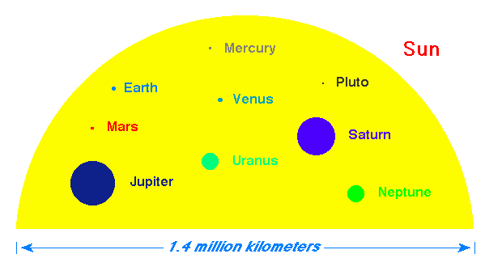
Activity 1: A Scale Model of the Inner Solar System
In Part 2, girls walk a scale model of our Solar System. Our Solar System is so large that looking at the actual values for plant sizes and the distances between planets and our Sun are just too hard to visualize. The activity’s scale model values are calculated by first assigning 20 cm (about 8 inches) to the Sun’s diameter. Our Solar System model is to scale for planet diameters as well as all distances. These calculations appear in Activity I directions.
Imagine the yellow half circle represents our Sun’s diameter. The colored dots are the diameters for each planet scaled to the yellow half circle. As with the elephant photos, no matter how large or small we make the graphic, the colored dot size relationships remain the same.
Sun’s Diameter
Image credit: University of Tennessee, Knoxville, Astronomy & Physics
©SETI Institute 2015 Activity 1: Scale Model of Solar System [Adult]
Notes:
http://csep10.phys.utk.edu/astr161/lect/solarsys/scale.html (image link)

Slide 6
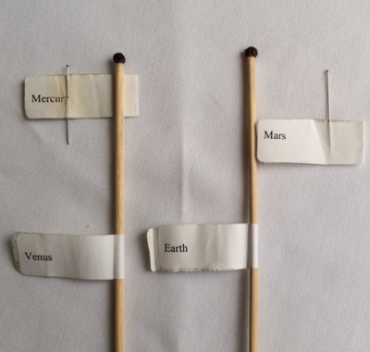
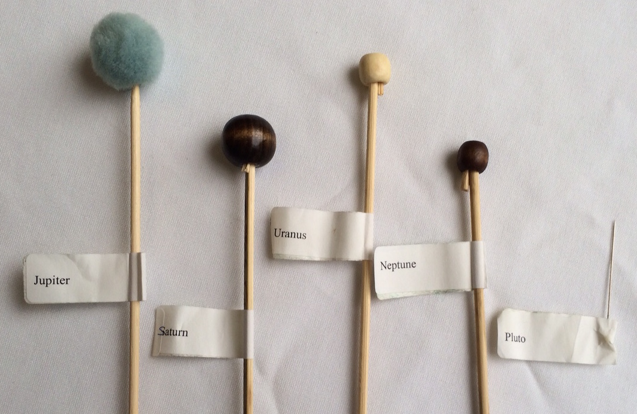
Activity 1: A Scale Model of the Inner Solar System
Materials-in-Brief:
2 - dolls or action figures
10- scaled objects representing inner and outer planets
2- labeled balls: Earth; Mars – ½ diameter of Earth’s ball
Scaled inner planet examples
Scaled outer planet examples (Pluto is a dwarf planet)
These scaled “planet” objects are suggestions for Activity 1.
©SETI Institute 2015 Activity 1: Scale Model of Solar System [Adult]
Notes:
http://www.noao.edu/education/peppercorn/pcmain.html

Slide 7
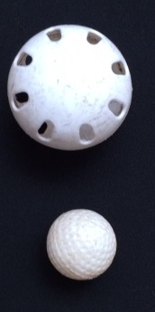
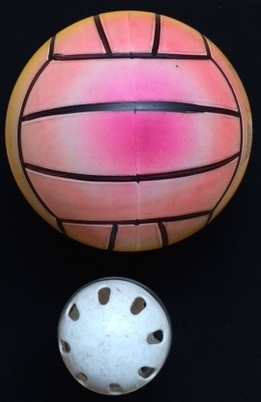
Activity 1: A Scale Model of the Inner Solar System
Materials-in-Brief:
2 - dolls or action figures
10- scaled objects representing inner and outer planets
2- labeled balls: Earth; Mars = ½ diameter of Earth’s ball
Earth
Earth
In each example, the Earth ball is twice the
diameter of Mars.
Mars
Mars
whiffle & golf ball examples
whiffle & plastic blow up ball examples
Reminder: Further details are located in the link below:
The Earth is a Peppercorn
©SETI Institute 2015 Activity 1: Scale Model of Solar System [Adult]

Slide 8
Activity 2: It’s All About the Atmosphere
Materials-in-Brief: Consult Activity for complete list
3 - quart-sized Ziploc® bags 4 cups plus [2] teaspoons clean sand
Big Picture Ideas:
Activity 2 uses grains of sand to represent the “particles” of gases that form atmospheres of planets. Gases are made up of tiny “bits” (molecules) too small to see. Much larger and heavier than gas molecules, sand grains are not an ideal model for an atmosphere. For instance, sand does not fill the baggie (our atmospheric container) the same way gas molecules do.
The graphic below compares our two models:
sand grain model
gas particles model*
Blue sand grains are close together and remain at the bottom of container. There is less space between grains. The grains are more densely packed.
Blue dots represent gas molecules. They are small, have more space between them and fill the container. These particles (molecules) are less densely packed.
*Note: atmospheres are composed of gas particles too small to see and too numerous to draw. This graphic is for illustration purposes only.
©SETI Institute 2015 Activity 2 It’s All About the Atmosphere [Adult]

Slide 9
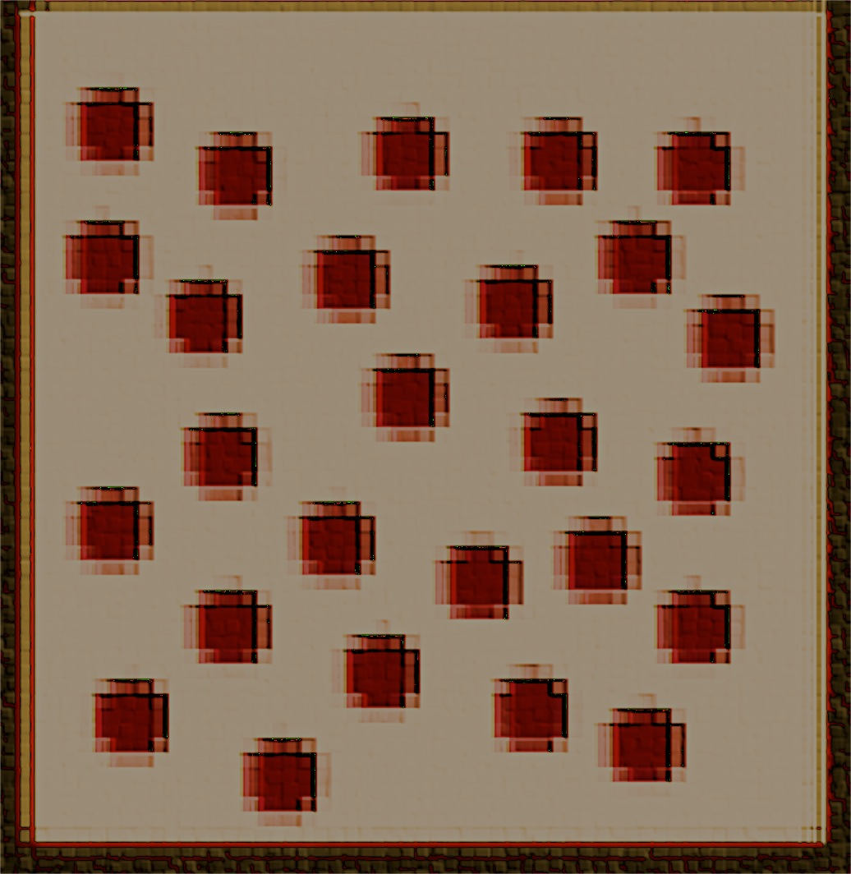
Activity 2: It’s All About the Atmosphere
Materials-in-Brief:
3 - quart-sized Ziploc® bags 4 cups plus [2] teaspoons clean sand
Developing, evaluating and using models is an important practice in science. Although not perfect, the sand grain model is useful and shows some important differences between planet atmospheres. The graphic below compares the sand grain and gas particle models for Venus, Earth and Mars from Activity 2.
sand grains model
Summary: On Earth and Mars, gas particles are farther apart and less densely packed than on Venus.
gas particles model
more dense less dense least dense*
*Gas “dots” for illustrating relative differences in planet atmospheres and not to suggest Mars’ has only one gas particle.
©SETI Institute 2015 Activity 2 It’s All About the Atmosphere [Adult]

Slide 10
Activity 3: The Magnetosphere & the Solar Wind
Materials-in-Brief: Consult Activity for complete list
1 – salt shaker with iron filings
1- bar magnet (7.6 cm or about 3 inch) + lid for Earth model several pea sized magnets + cup for Mars model
1-straw
Big Picture Ideas:
In Activity 3 girls observe planet models for the presence of magnetic field lines that are evidence for a magnetic field. A magnetic field is important to protect an atmosphere. Briefly, girls build two models: (1) Earth – a single covered bar magnet that represents Earth’s core, and (2) Mars – several covered small irregularly shaped magnetic pieces that reflect current scientific views about Mars’ interior. Then iron filings are lightly sprinkled over each model to make magnetic field lines visible. Hole punches that track the solar wind (provided by a girl’s breath) are blown over each model to observe any changes in the location of iron filings. Unlike Earth, the Mars model will show no evidence of a magnetic field, which would leave Mars’ atmosphere open to attack by solar winds.
©SETI Institute 2015 Activity 3: Magnetosphere and the Solar Wind [Adult]

Slide 11
Activity 3: The Magnetosphere & the Solar Wind
To observe magnetic field lines, iron filings must be sprinkled lightly over the bar magnet and surrounding area. Leaders should mention that too many iron filings will hide the pattern of magnetic field lines. Although tempting, this is not an appropriate time for the girls to play with the magnets & iron filings. Play creates a mess and possible safety hazard.
Check the below images for outcomes that are “correct” and “incorrect” techniques.
bar magnet
Appropriate amount of iron filings
Excessive iron filings
These lines are evidence of a magnetic field.
Note: Correct: Greater amount of iron filings attracted to bar magnet and smaller amounts at periphery, illustrating magnetic fields generated by the bar magnet.
Note: Incorrect: An excess amount of iron filings cover bar magnet and more around the edges obscure the pattern of magnetic field lines.
©SETI Institute 2015 Activity 3: Magnetosphere and the Solar Wind [Adult]

Slide 12
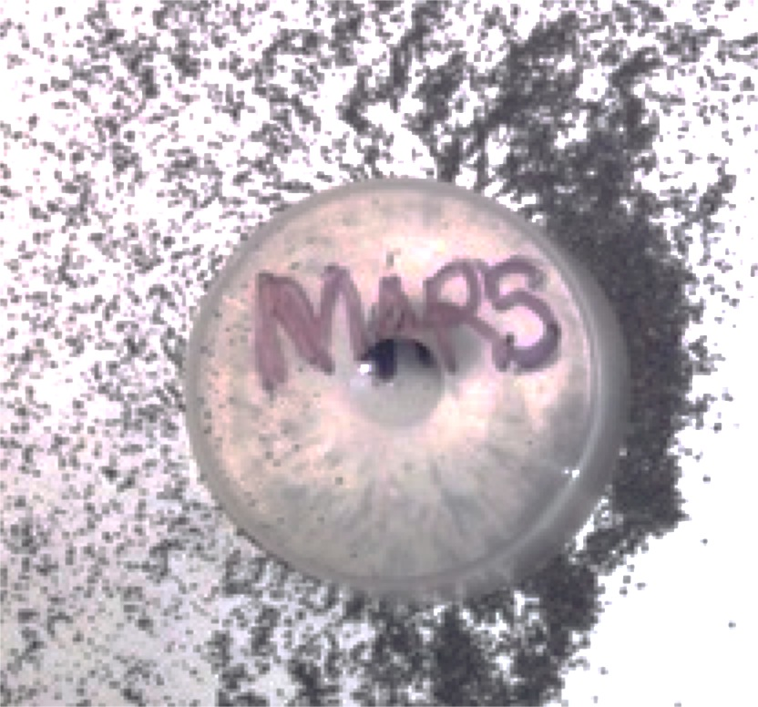
Activity 3: The Magnetosphere & the Solar Wind
As previously mentioned, the purpose of iron filings is to make visible magnetic field lines that are evidence for a planet’s magnetic field.
Note:
Earth model shows a distinct pattern
of iron filings.
Mars model iron filings are scattered randomly.
Earth: Evidence of magnetic field lines.
Mars: Little evidence of a magnetic field in this model.
©SETI Institute 2015 Activity 3: Magnetosphere and the Solar Wind [Adult]

Slide 13
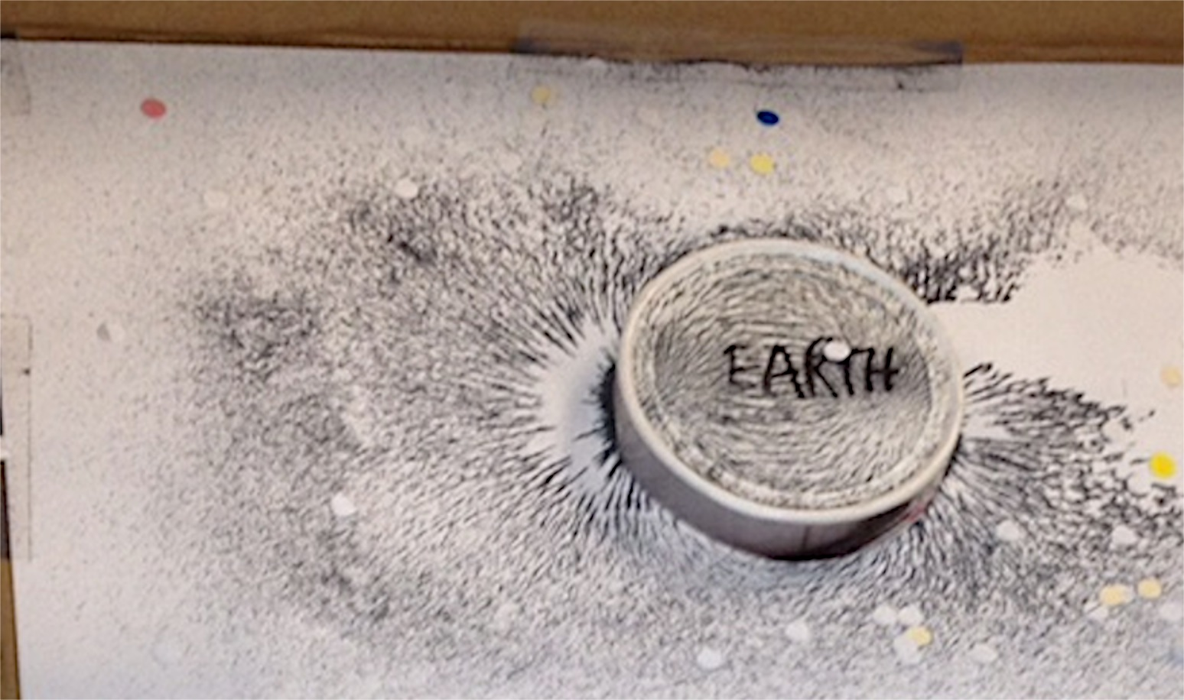
Activity 3: The Magnetosphere & the Solar Wind
Later in Activity 3, girls are asked to blow hole punches softly through a clean straw towards their models of Mars and Earth. (Remind everyone to take the straw out of their mouths before they inhale.)
iron filings
Note: Hole punches act as a tracer that model the effects of the solar wind.
The girl’s breath must be strong enough to move the hole punches forward but not so strong as to disrupt the pattern of iron filings.
Large bar magnet under Earth model
hole punches
Most blown hole punches are found farther away from the Earth model than when compared to the Mars model.
Earth shows evidence of a magnetic field that deflects the solar wind (hole punches) thus Earth’s atmosphere is protected.
©SETI Institute 2015 Activity 3: Magnetosphere and the Solar Wind [Adult]

Slide 14
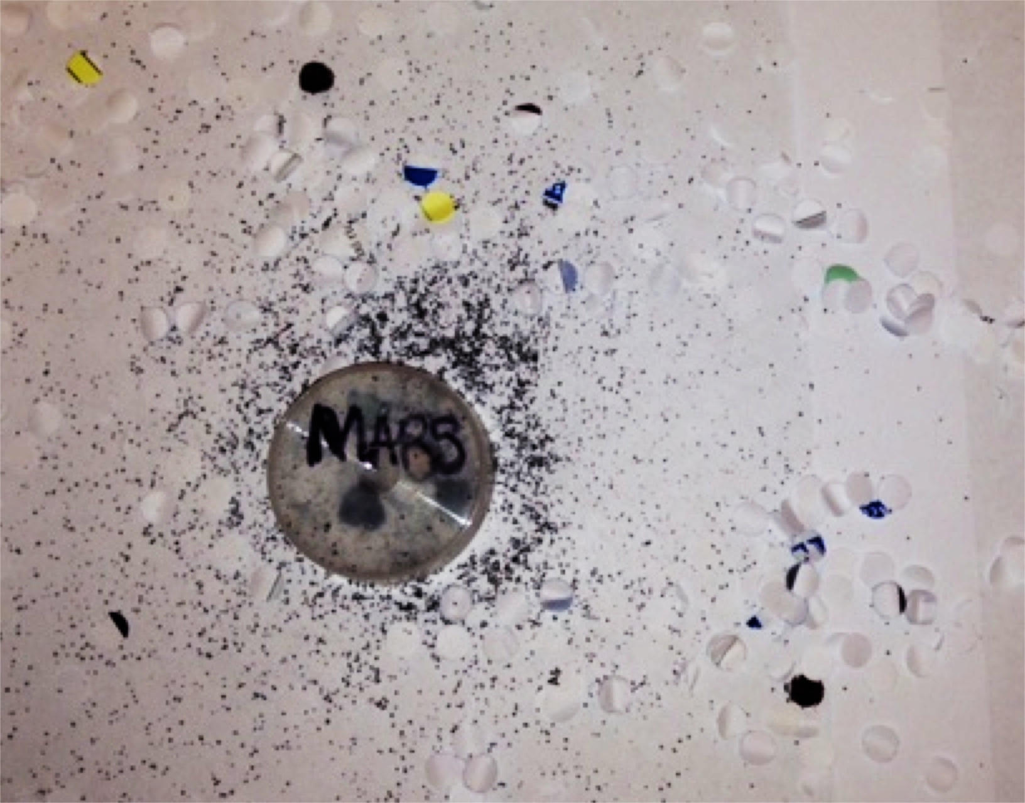
Activity 3: The Magnetosphere & the Solar Wind
Compare the result of blowing hole punches towards the model of Mars:
iron filings
hole punches
Smaller magnet pieces under Mars model.
Note: Blowing too strongly through the straw creates too much force, scattering iron filings and hole punches.
Most blown hole punches are randomly mixed in with iron filings and are near Mars model
Mars shows little or no evidence of a magnetic field
to deflect the solar wind (hole punches) in this model and Mars’ atmosphere is not protected.
©SETI Institute 2015 Activity 3: Magnetosphere and the Solar Wind [Adult]

Slide 15
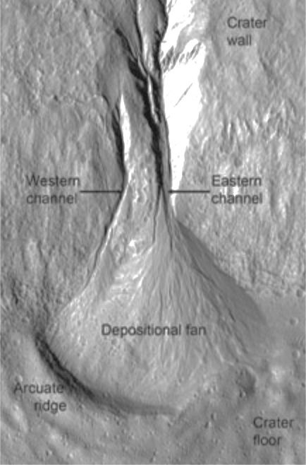
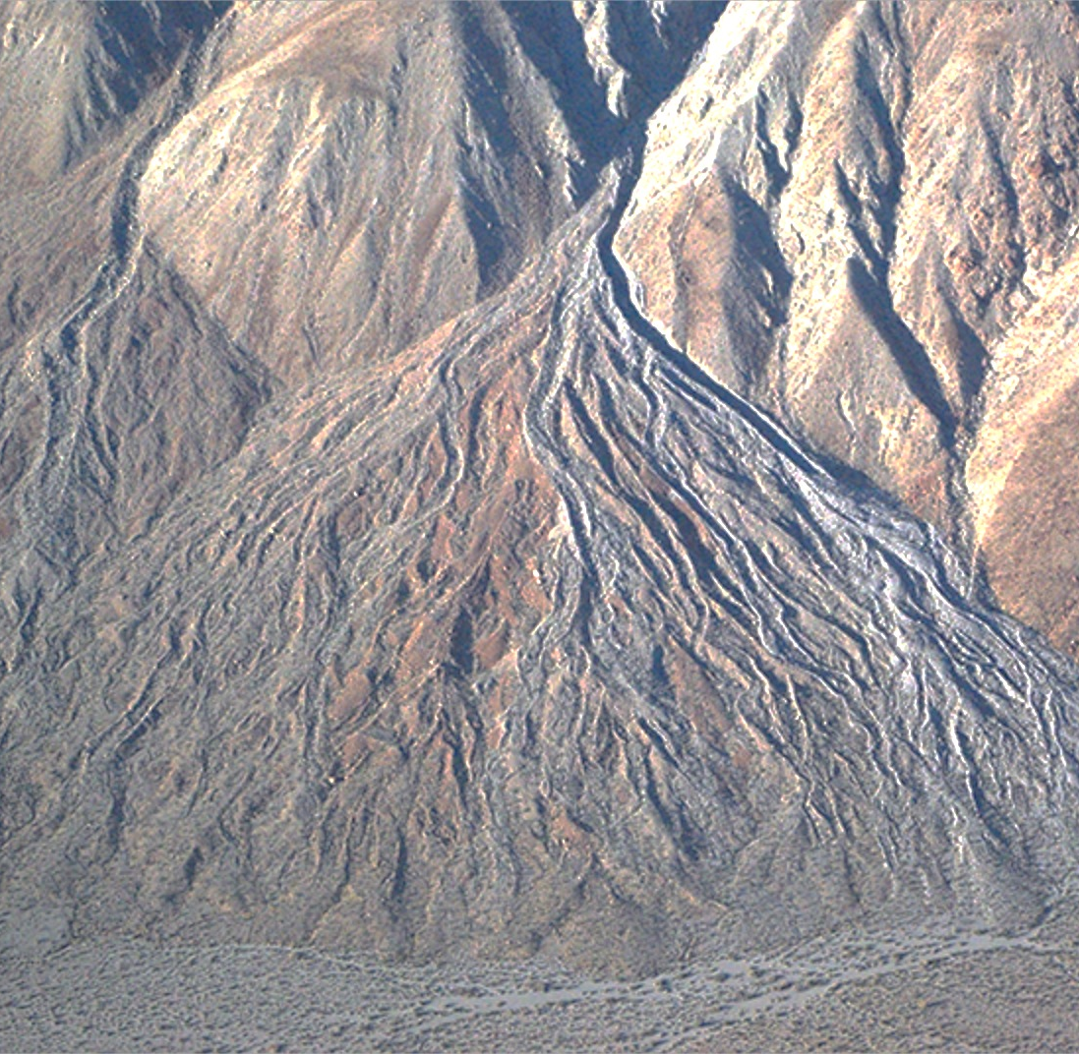
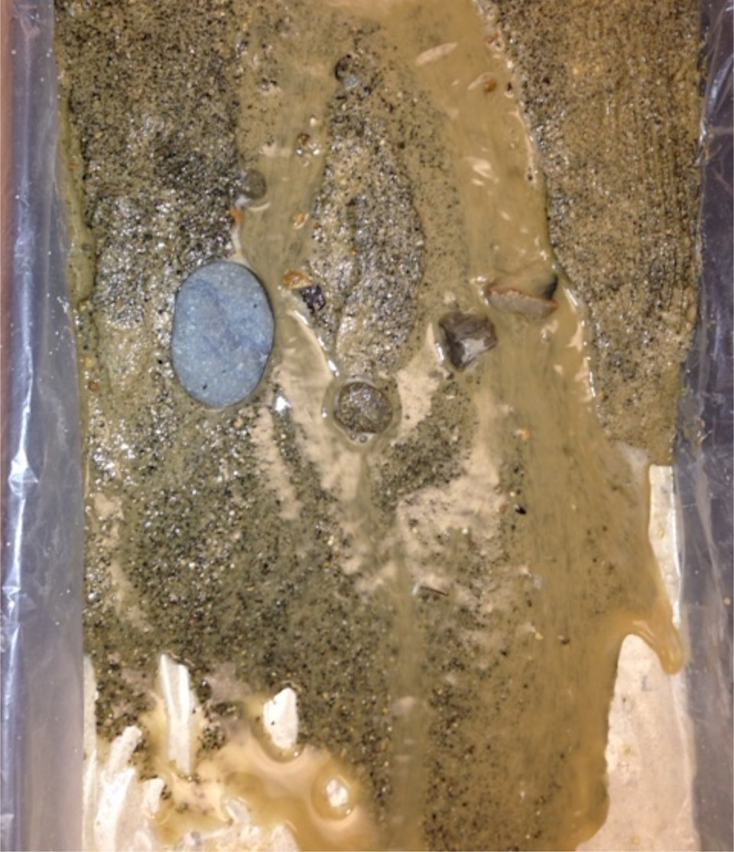
Activity 4: Water Surface Features
Materials-in-Brief Consult Activity for complete list
1- prepare Steam Table
heterogeneous sand
Big Picture Ideas:
In Activity 4, girls compare Earth and Mars for common features of water erosion. Ongoing water flow is evidence that supports a once thicker atmosphere on Mars. Experimenting with a stream table, girls produce alluvial fans, which are made in nature by water running over mountains, hills and steep canyon walls as seen below: The images represent alluvial fans on Mars, Earth and from stream table experiments.
channels
channels
Alluvial Fan
Alluvial Fan
Mars: dated about 1.25 million years ago. Credit: NASA/JPL
Santa Rosa Mountains, CA Credit: Water.CA.Gov
Stream Table Model
©SETI Institute 2015 Activity 4 Water Surface Features [Adult]
Notes:
http://mepag.jpl.nasa.gov/topten.cfm?topten=1

Slide 16
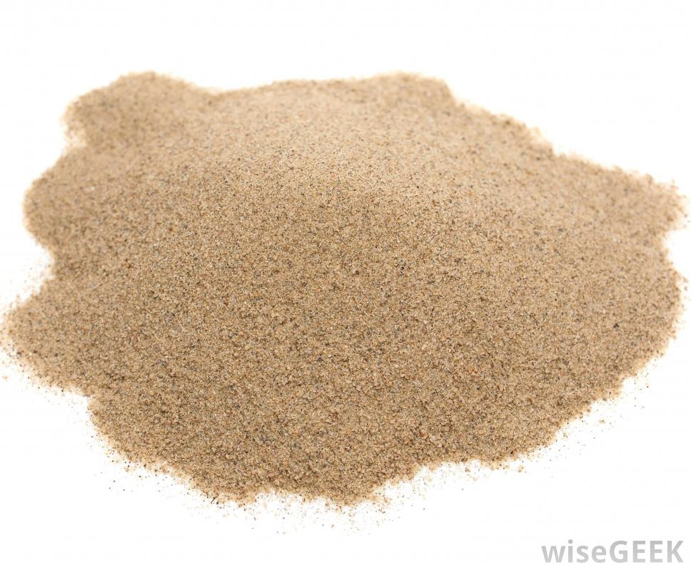
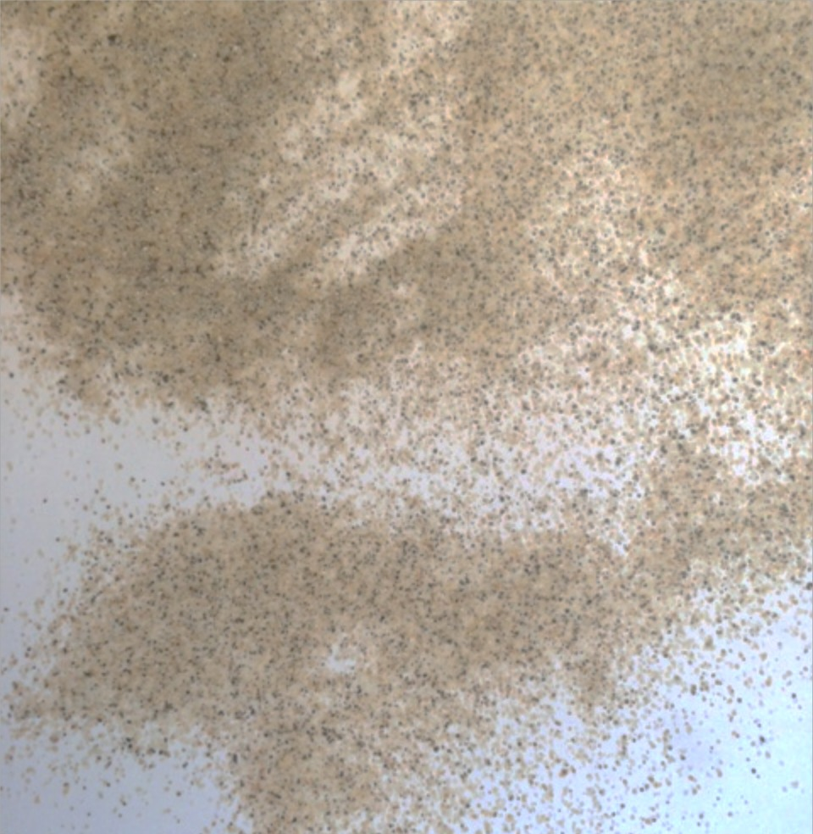
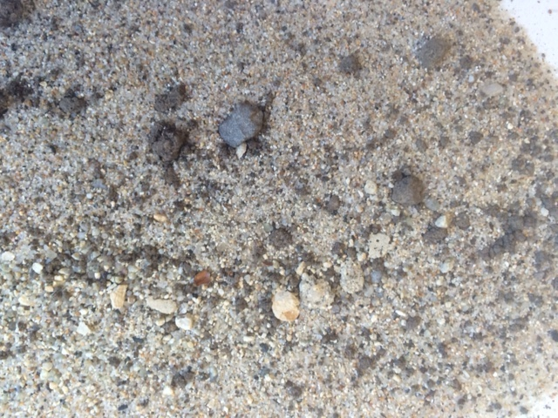
Activity 4: Water Surface Features
Materials-in-Brief: (Check activity for complete list)
1- prepare stream table
heterogeneous sand (mixed sizes)
Selection and Sources of the Proper Sand Mixture for your Steam Table Model
How do alluvial fans develop? Fans are produced from gravel, sand and small bits of sediment when the water interacts with canyon walls, mountains, hills and then spills out onto valley floors. ***Your sand mixture needs to contain a variety of particle sizes that reflects this journey.
Where can you look for your materials? Collect materials (regulations permitting) from beaches, dry stream and creek beds. Purchase part or all of a suitable mixture with the following caveats: Sandblast sand (grit) does NOT work; whereas, sand used for preparing concrete or mortar found at building supply stores is acceptable. See images below for suitable and unsuitable examples:
Sand particles are mostly the same size.
Add in other particle sizes.
Sandblast grit:
Do not use.
©SETI Institute 2015 Activity 4 Water Surface Features [Adult]

Slide 17
Activity 4: Water Surface Features
Materials-in-Brief: Consult Activity for complete list
1- prepare stream table
heterogeneous sand
Once you have a sand mixture and other materials assembled for the Stream Table Model, the rest is as straightforward as 1, 2, 3!
Get the plastic tray ready: Some plastic plant trays have a pattern in the bottom. Use a thin layer of smaller particle sand to create a smooth surface.
Note small straw-sized white appearing drain hole
you can create with a pair of scissors.
Layer of sand is just thin enough to smooth out any pattern in the bottom of the plastic plant tray.
©SETI Institute 2015 Activity 4 Water Surface Features [Adult]

Slide 18
Activity 4: Water Surface Features
Materials-in-Brief: Consult Activity for complete list
1- prepare stream table
heterogeneous sand
Get test surface ready: Cover the smooth sand with a thin plastic sheet so that later on the girls can lift this plastic sheet, “re-set” their alluvial fan and produce a new fan.
plastic sheet
sand mixture
Cut the small straw sized drain hole in plastic too! Check to be sure plastic lines up with the opening in tray.
Cover about 1/3 of plastic surface with generous layer of sand mixture.
©SETI Institute 2015 Activity 4 Water Surface Features [Adult]

Slide 19
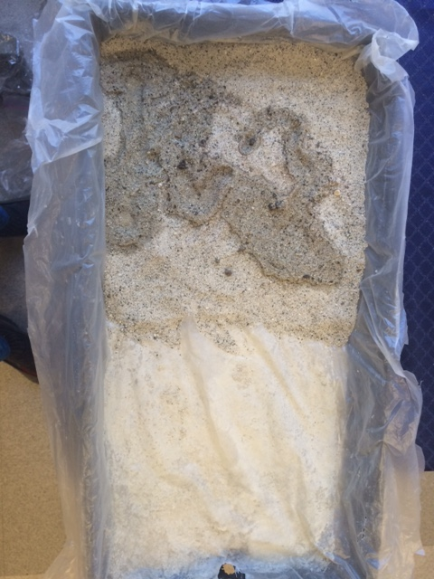
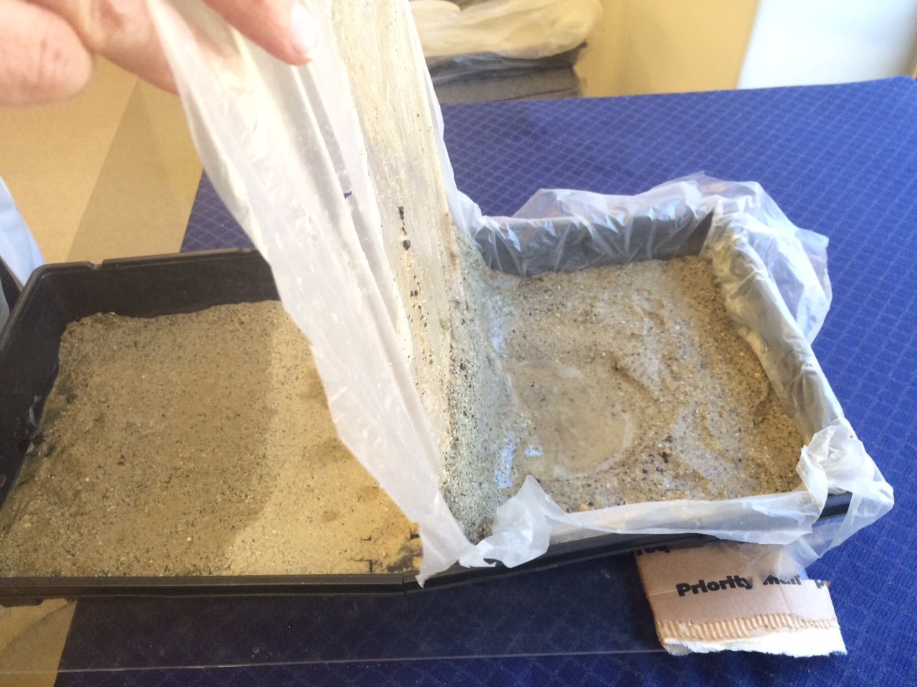
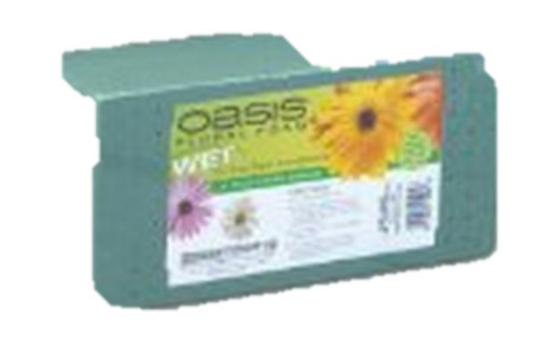
Activity 4: Water Surface Features
Materials-in-Brief Consult Activity for complete list
1- prepare stream table
heterogeneous sand
The sand mixture should be very damp before starting the activity. Wet sand evenly with a spray bottle of water or pour water slowly from a cup. We encourage adult leaders to practice this ahead of time! Stream Table Models may be prepared the day before, covered with plastic wrap and lightly re-wetted if needed.
How to “re-set” Stream Table
wet mixture (all sand needs to look this wet)
dry mixture - add more water so it is completely damp
plastic sheet with sand underneath
CHECK: Drain hole lines up with water catch bucket!!
Use slices of florist foam to lift the tray about 10 degrees
©SETI Institute 2015 Activity 4 Water Surface Features [Adult]

Slide 20
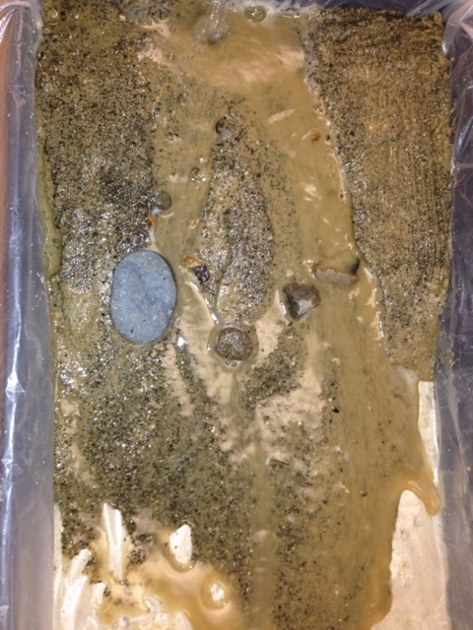
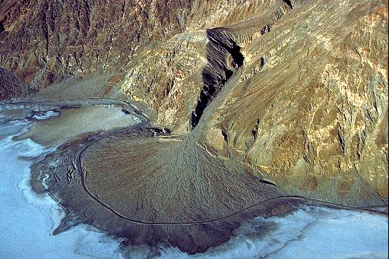
Activity 4: Water Surface Features
Materials-in-Brief: Consult Activity for complete list
1- prepare stream table
heterogeneous sand
Make an alluvial fan: To produce an alluvial fan may take a little practice, but it’s easy to re-set the sand mixture and try again. These alluvial fans are important. They show features that link evidence of flowing water on Earth with Mars. This evidence adds support in favor of a more robust atmosphere for Mars at an earlier time.
Water flow
here
Pour water
here
rock
Stream Table Model:
alluvial fan
Earth: alluvial fan
Image credit: windows2universe
©SETI Institute 2015 Activity 4 Water Surface Features [Adult]

Slide 21
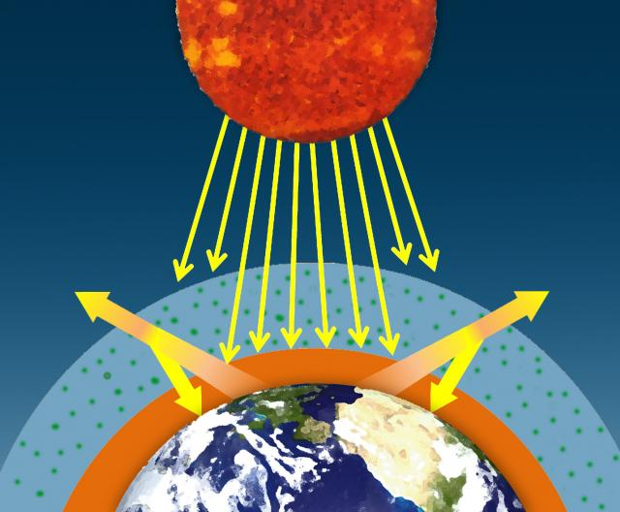
Activity 5: The Greenhouse Effect
Materials-in-Brief: Consult Activity for complete list
1- prepare Atmosphere Model Chamber
1- temperature sensitive film
Big Picture Ideas: (This Activity relates to “Breathe: It’s Your Planet- Love It! A Leadership Journey”)
Activity 5 explores another way atmospheres can change over time:the effect of greenhouse gases. About half of the Sun’s visible light passes through our atmosphere. This energy can be soaked up by surface features such as land and water or bounced back into space in the form of heat energy. However, not all of that heat energy reaches space. Greenhouse gases like
water and carbon dioxide trap the heat energy, which ends up going back towards Earth’s surface. This is known as the greenhouse effect.
Sun
In Part 1 of Activity 5, girls explore heat sensitive film that detects heat (infrared) energy coming from their hands and also from the infrared heat lamps used in Part 2.
In Part 2, the group uses an Atmosphere Model Chamber to test the effect of water vapor, a greenhouse gas, on the air’s temperature in the presence of infrared energy produced by a heat lamp.
visible light
infrared
Credit: Climate Science Investigations - NASA
©SETI Institute 2015 Activity5 The Greenhouse Effect [Adult]

Slide 22
Activity 5: The Greenhouse Effect
Materials-in-Brief: Consult Activity for complete list
1- prepare Atmosphere Model Chamber
1- temperature sensitive film
In Part I: important for Adult Leaders to review: (1) Activity directions and precautions with girls (2) Why everyone is strongly encouraged to wear safety glasses.
PRECAUTIONS:
(1) Heat lamp bulbs can break if they are bumped or dropped. Lamps are shock sensitive and can produce fine shards of sharp glass.
(2) When turned on for a short time, heat lamps can get very hot. Caution girls to be aware of where the heat lamp apparatus is located. Keep the electrical cord away from the heat lamp.
(3) Heat-sensitive film is easily and permanently damaged if held too close or for too long in front of a hot lamp. If the film gets bubbly, it’s ruined.
©SETI Institute 2015 Activity5 The Greenhouse Effect [Adult]

Slide 23
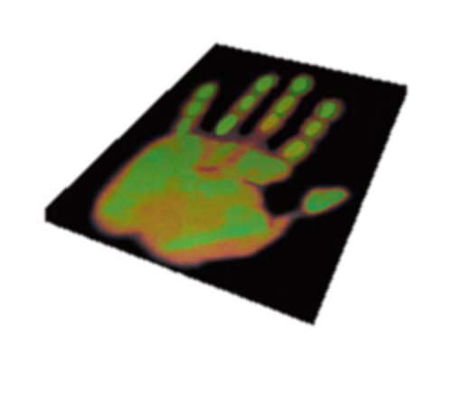
Activity 5: The Greenhouse Effect
Materials-in-Brief: (Check activity for complete list)
1- prepare Atmosphere Modell Chamber
1- temperature sensitive film
Part 1: This activity is a great deal of fun!!
To explore infrared heat energy, girls use their hands and an infrared heat lamp as energy sources and a heat-sensitive film as a detector.
Note: The film requires a warm surface on both sides for good results. if it is a cool day or the room is cold, girls can warm their hands by sitting on them, rubbing them together or even briefly turning the heat lamp on and holding their hands at a safe distance (remind someone to turn the lamp off again).
There are two sides to the film, but only the shiny side will display the color changes. When the film is too cold or even too hot, the film is black. The color changes occur between 35 and 40 °C (about 95 to 104 °F)
film
Place hands on both sides of film so that each finger matches up..
Hand print result
©SETI Institute 2015 Activity5 The Greenhouse Effect [Adult]

Slide 24
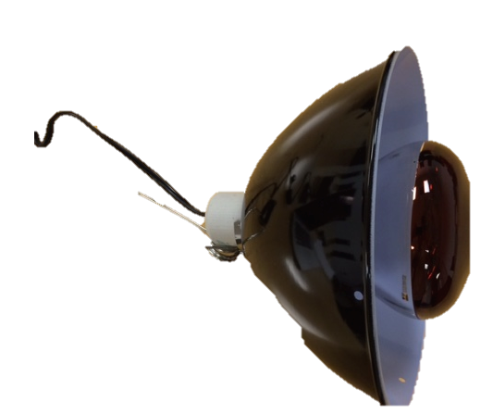
Activity 5: The Greenhouse Effect
Materials-in-Brief: (Check activity for complete list)
1- prepare Atmosphere Model Chamber
1- temperature sensitive film
What does heat sensitive film tell you when it changes color? Imagine where your hand feels cold and where it feels warm. When our hands are wet and the wind blows, what parts cool off first? (Answer: Fingers – where we lose heat most easily.)
Hand print is: greenish - blue in the hottest areas & orange-red in the least warm (coolest) areas
This is opposite to what we learn in art!
CAUTION: Keep hot heat lamp 6 inches away from film.
heat sensitive
film
Leave lamp turned
off when not in use.
©SETI Institute 2015 Activity5 The Greenhouse Effect [Adult]

Slide 25
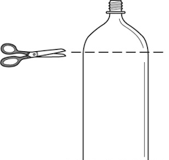
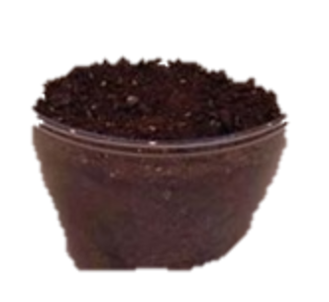
Activity 5: The Greenhouse Effect
Materials-in-Brief: (Check activity for complete list)
1- prepare Atmosphere Model Chamber
1- temperature sensitive film
In Activity 5, leaders may assemble model chamber ahead of time or with adult guidance, girls may build chambers as part of the activity. When cutting the top off the 2-liter plastic soda bottles, remind the girls to measure the height, then use a sharpie to mark a line for the scissors to cut. Caution: Cut plastic edges are rough and starting the first cut on the line requires careful use of scissors. Tip: Squeeze and pinch & snip the plastic bottle to make the initial cut.
plastic + rubber band
Caution: rough edges
+
+
=
1 cup moist dirt
©SETI Institute 2015 Activity5 The Greenhouse Effect [Adult]

Slide 26
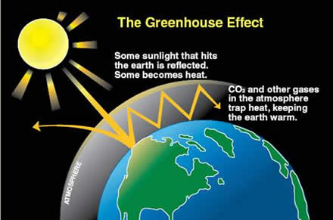
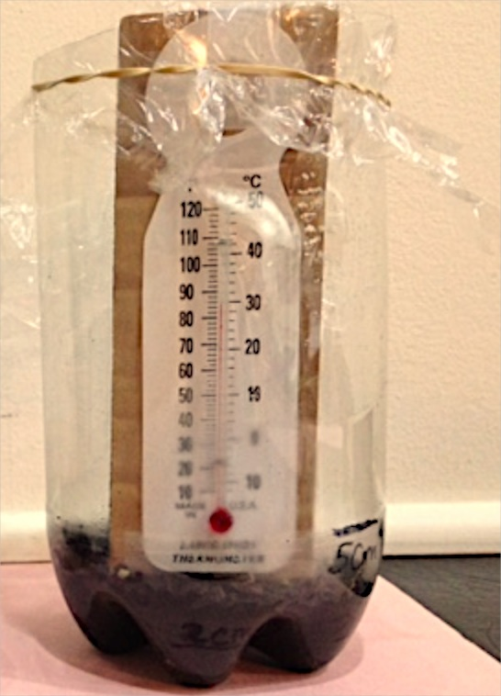
Activity 5: The Greenhouse Effect
Materials-in-Brief: (Check activity for complete list)
1- prepare Atmosphere Model Chamber
1- temperature sensitive film
In Part 2 girls use the heat lamp to produce changes in temperature inside the Atmosphere Model Chamber which contains water vapor (an important greenhouse gas) in our air.
“cloud cover”
(water)
Infrared source
Credit: NASA
Our test chamber models an atmosphere with clouds (plastic wrap) and very moist soil (earth). While our model has limitations (plastic wrap is not the same as a cloud layer), girls will observe when s greenhouse gas (water vapor) is trapped and warmed, the air temperature goes up.
©SETI Institute 2015 Activity5 The Greenhouse Effect [Adult]

Slide 27
Activity 6: Steps Along the Journey: Global Warming
Materials-in-Brief: (Check activity for complete list)
1- Breath – It’s Your Plant – Love It! A Leadership Journey
1 – Copy of questions and answers from GGTM Activities 1 & 5.
Big Picture Ideas:
Now is the time to connect what the girls learned in the GGTM activities to the Breathe awards along the Breathe journey. Activity 6 guides adult leaders and girls through a review of current evidence that increases their AWARENESS of our world’s air quality and ALERTS them to the effects of burning fossil fuels and the amount of carbon dioxide in our atmosphere. Girls AFFIRM they care about the air we breathe, form an Air Care Team (ACT) and agree on an Action Plan to educate and inspire others. At the conclusion, team members collaborate on a step-by-step written document to show they are AWARE and ALERT, and can AFFIRM how to take action. Suggested action projects are included in Activity 6.
©SETI Institute 2015 Activity 6: Steps Along the Journey

Slide 28
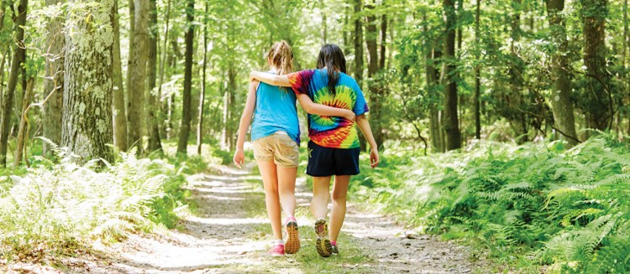
Activity 6: Steps Along the Journey: Global Warming
Materials-in-Brief: (Check activity for complete list)
1- Breath – It’s Your Plant – Love It! A Leadership Journey
1 – Copy of questions and answers from GGTM Activities 1 & 5.
Evidence Review
Seeing the forest for the trees….(Breathe Journey – pp. 52-53) “Imagine you are walking in a forest and can hear trees, shrubs, and plants breathing. When the sun shines, you might sense a big inhale as trees and plants take in carbon dioxide…” from fossil fuels, and also exhaled from our lungs. Those same plants give back oxygen in return. This process is called photosynthesis.
Girls take in oxygen and give off carbon dioxide.
Plants take in carbon dioxide and give off oxygen. Credit: www.girlscouts.org
Carbon dioxide is increasing, but is oxygen keeping pace? What happens if we have too much carbon dioxide?
©SETI Institute 2015 Activity 6: Steps Along the Journey

Slide 29
Activity 6: Steps Along the Journey: Global Warming
Materials-in-Brief: (Check activity for complete list)
1- Breath – It’s Your Plant – Love It! A Leadership Journey
1 – Copy of questions and answers from GGTM Activities 1 & 5.
Evidence Review
In Touch with Air (Breathe Journey pp. 33 – 37) What gas is winning the race between carbon dioxide and oxygen? And does the outcome of this race matter?
What do the total numbers
tell us? Are we losing or gaining
carbon in our atmosphere? Add
the numbers for “up” arrows and
also add up the numbers for the
“down” arrows. You will see that carbon is winning the race.
©SETI Institute 2015 Activity 6: Steps Along the Journey

Slide 30
Activity 6: Steps Along the Journey: Global Warming
Materials-in-Brief: (Check activity for complete list)
1- Breath – It’s Your Plant – Love It! A Leadership Journey
1 – Copy of questions and answers from GGTM Activities 1 & 5.
Summary of Evidence
After 20 years of study, a government
panel has concluded that the evidence
of global warming and its link to fossil
fuel emissions is “unequivocal.” Global warming is more than just small
degree shifts in temperature . (pg. 34)
Over time, those greenhouses gases have been on the rise, leading to a gradual warming of Earth’s temperatures, both on land and in the oceans. This temperature rise… is known as global warming or climate change. (pg. 33)
©SETI Institute 2015 Activity 6: Steps Along the Journey

Slide 31
Activity 6: Steps Along the Journey: Global Warming
Materials-in-Brief: (Check activity for complete list)
1- Breath – It’s Your Plant – Love It! A Leadership Journey
1 – Copy of questions and answers from GGTM Activities 1 & 5.
Action Plan Suggestions for Air Care Teams:
Community gardens
Save energy
Take
Action
Recycle Projects
Conserve fossil fuels
©SETI Institute 2015 Activity 6: Steps Along the Journey

Slide 32
Terms: “Click” on the link
Green house gases: In addition to CO₂ (carbon dioxide) there are other greenhouse gases. These gases include water vapor, methane, nitrous oxide, and ozone.
Green house effect (video) : During the day, the Sun shines through the atmosphere. Earth's surface warms up in the sunlight. At night, Earth's surface cools, releasing the heat back into the air. But some of the heat is trapped by the greenhouse gases in the atmosphere. That's what keeps our Earth a warm and cozy 59 degrees Fahrenheit, on average.
Climate vs. Weather: Weather is what the atmospheric conditions are over a short period of time, and climate is how the atmospheric “behaves” over relatively long periods of time. In other words, the difference is a matter of time.
Climate Change: Climate change is a long-term shift in the statistics of the weather (including its averages) for a given place and time of year.
Global Warming: An increase in Earth’s average surface temperature due to rising levels of greenhouse gases.

